Slide 1
asynkron

Slide 2
helleborg

Slide 3

Helleborg AS

Slide 4
proto.actor

Slide 5
proto.actor

Slide 6
proto.actor

Slide 7
actor model

Slide 8
cloud objects

Slide 9


cloud native

Slide 10
microservices

Slide 11
observability

Slide 12
data streams

Slide 13
extensible

Slide 14

ultra fast

Slide 15
concurrency

Slide 16
concurrent

Slide 17
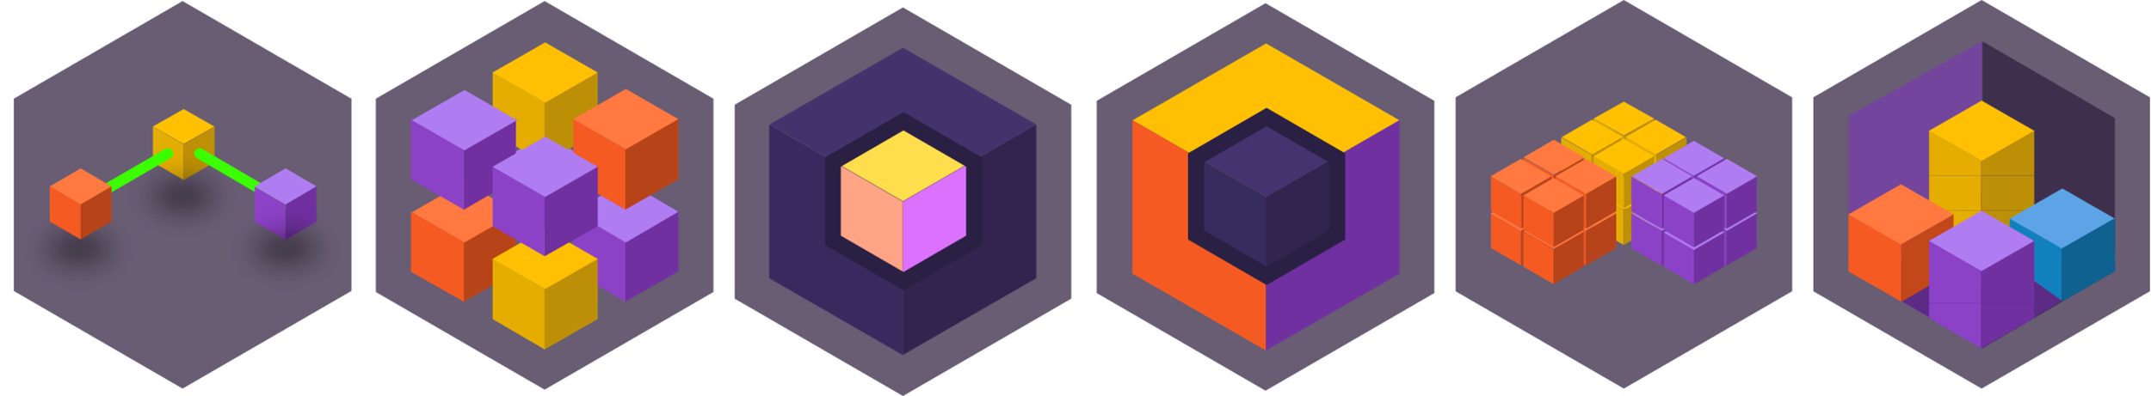


Slide 28



A
B
C

Slide 29

A
B
C

Slide 30
A
B
C

Slide 31



Slide 32


Slide 33


Slide 35
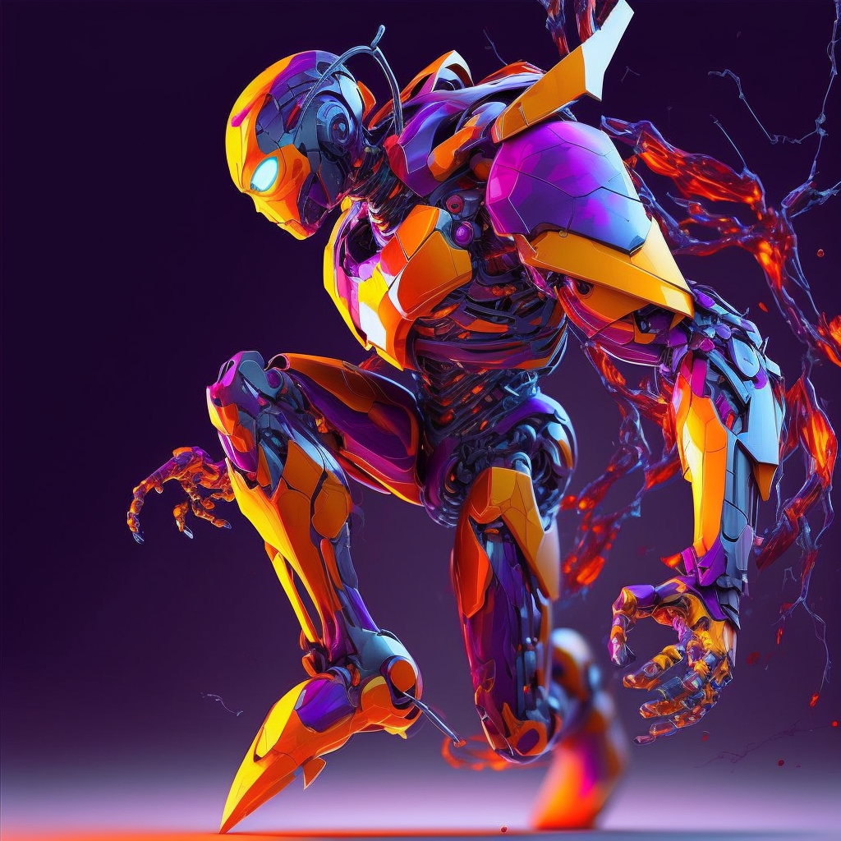

Slide 36


Slide 37


Slide 38


Slide 39


Slide 40


Slide 41
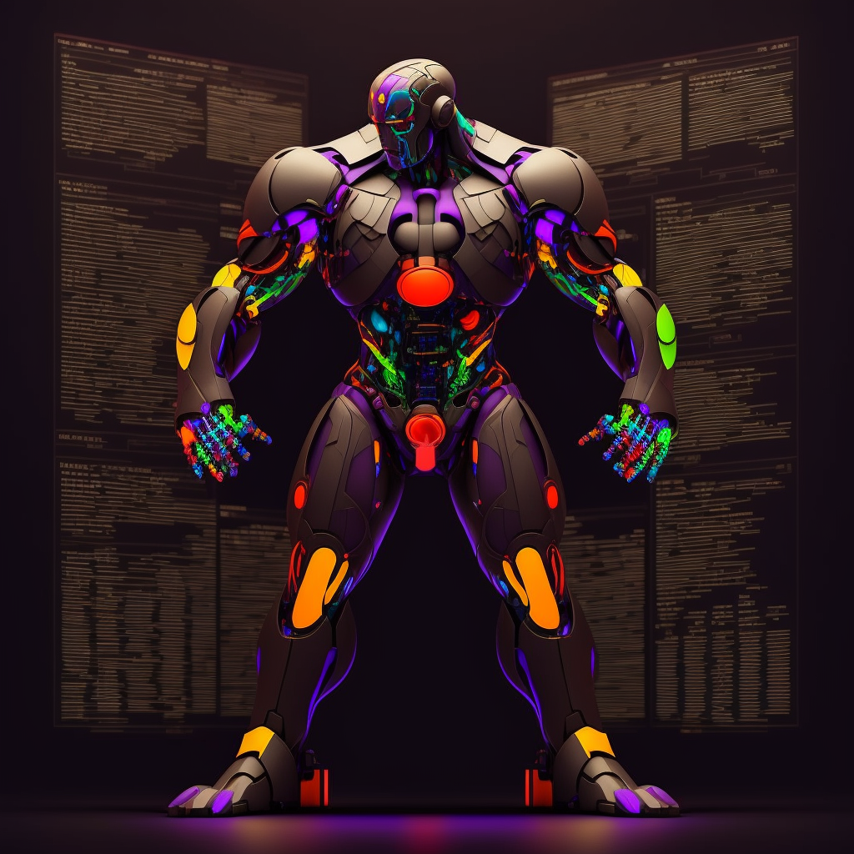

Slide 42
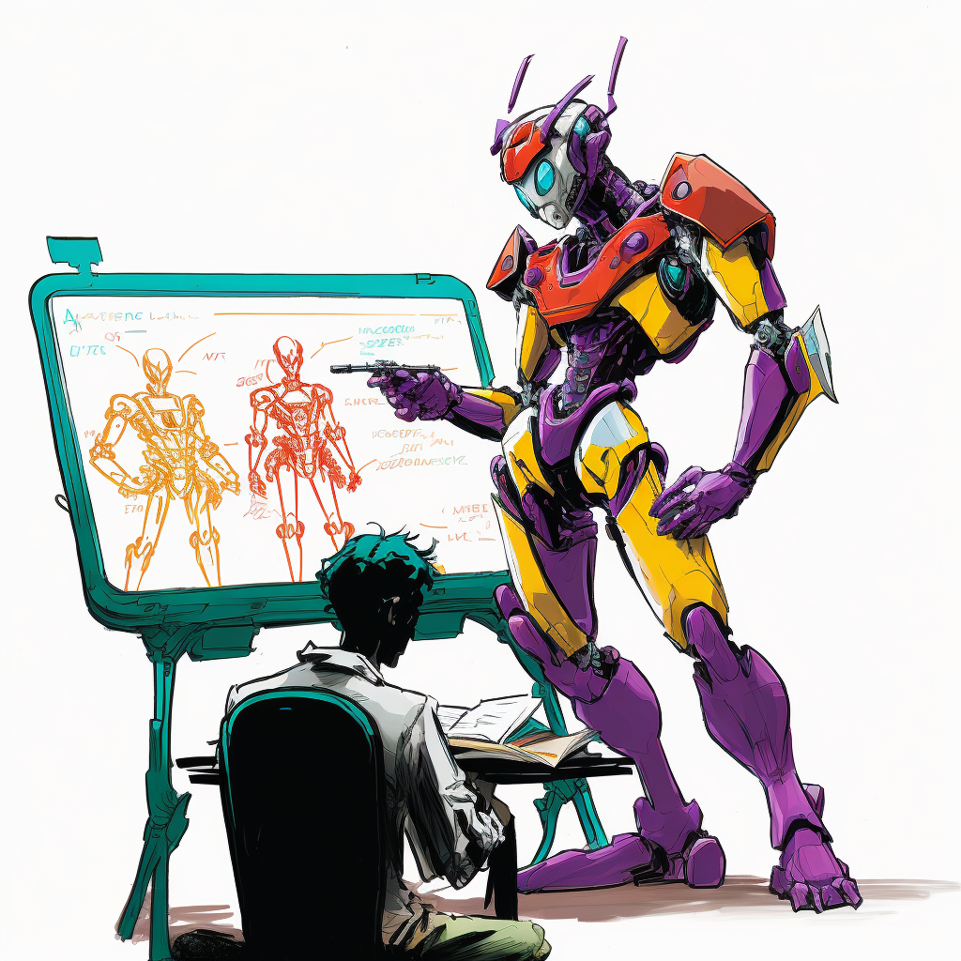

Slide 43
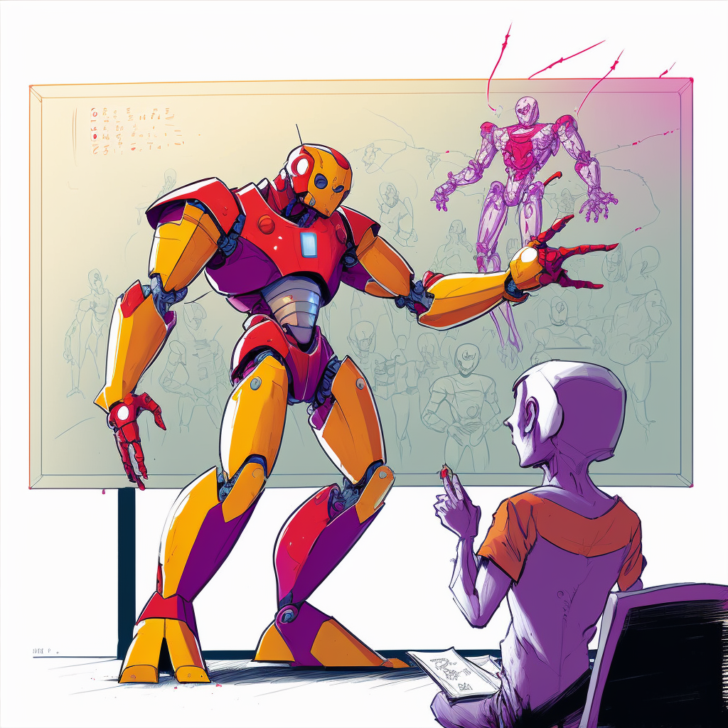

Slide 44
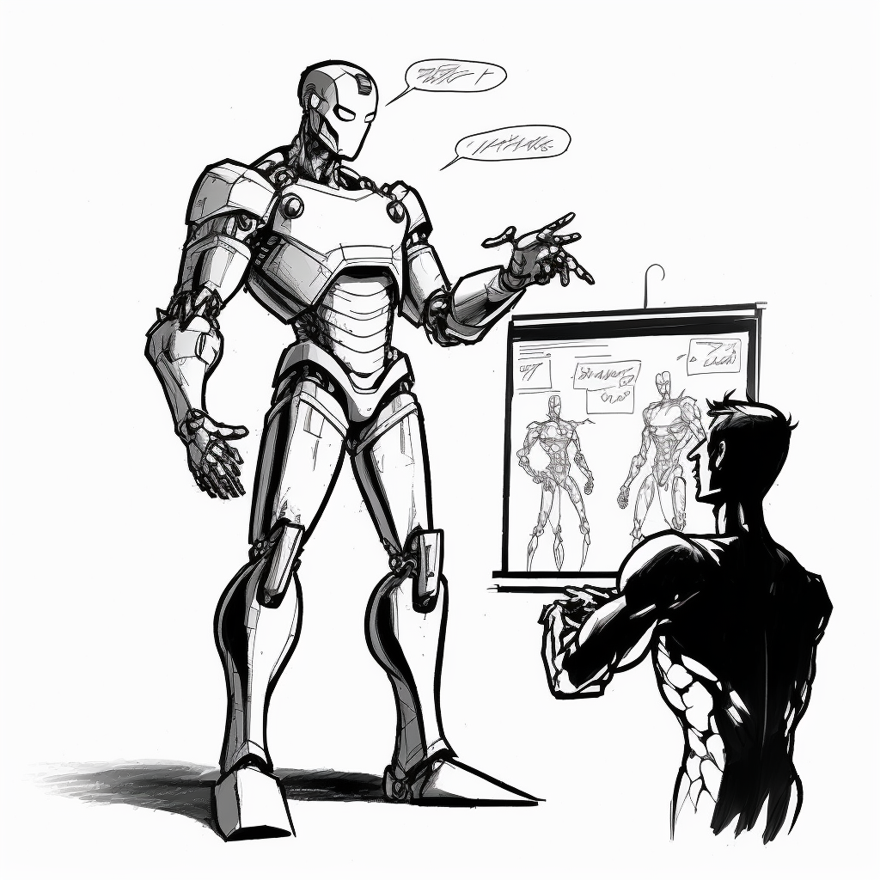

Slide 45
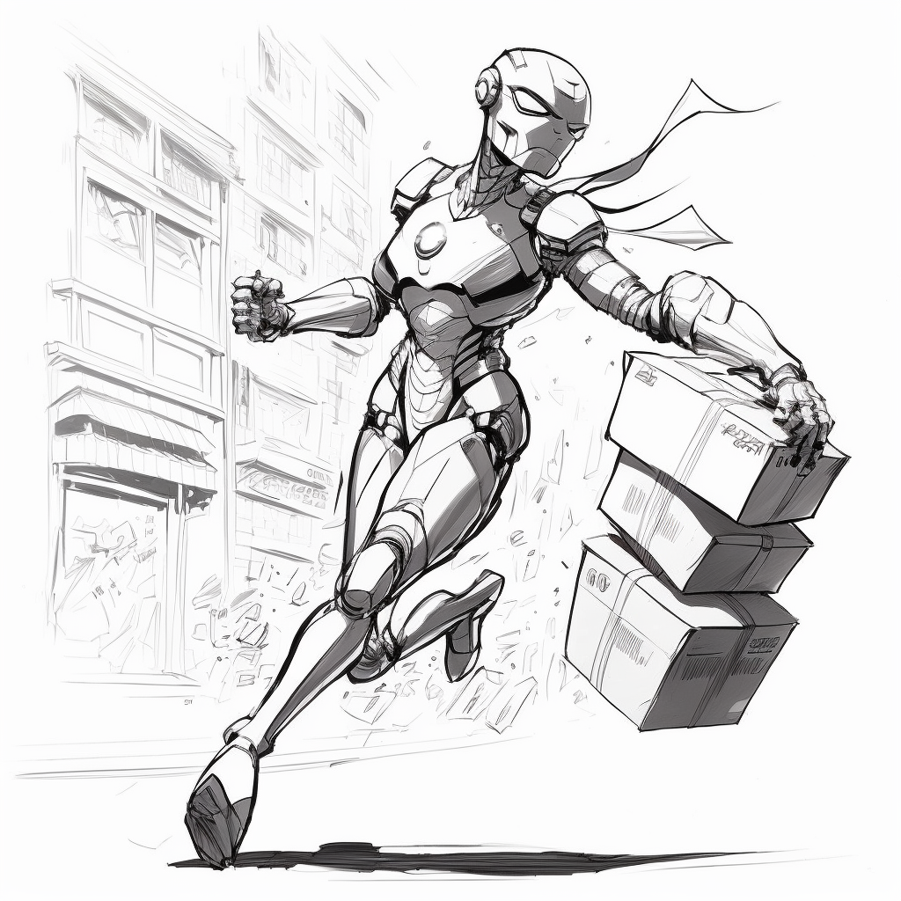

Slide 46


Slide 47
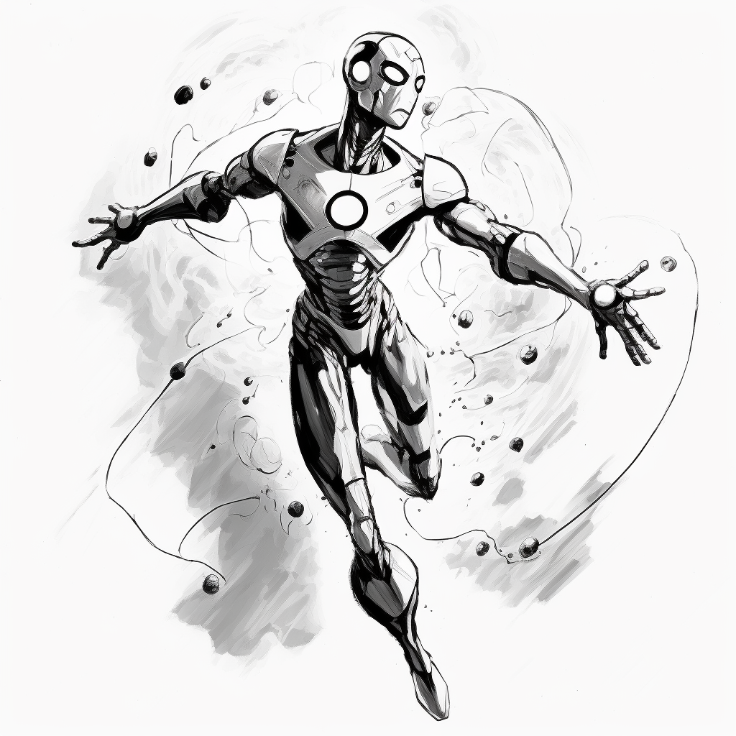

Slide 48





